Slide 1
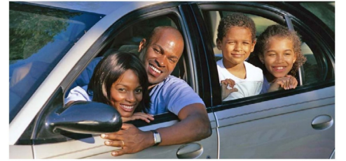
Going Places

Slide 2
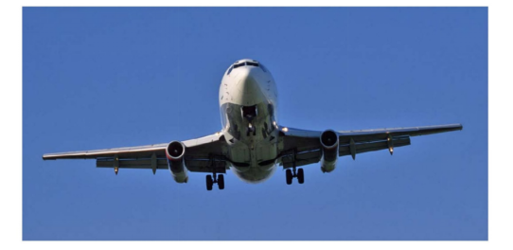
You can go on a plane.

Slide 3
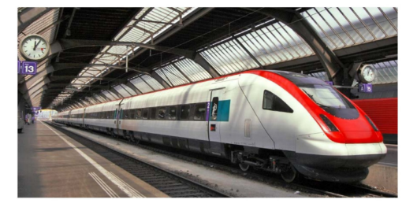
You can go on a train.

Slide 4
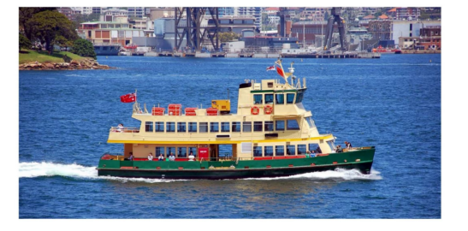
You can go on a boat.

Slide 5
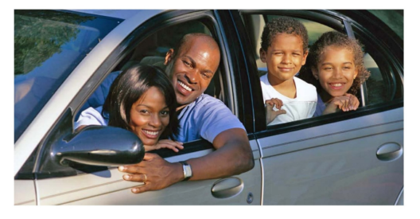
You can go in a car.

Slide 6
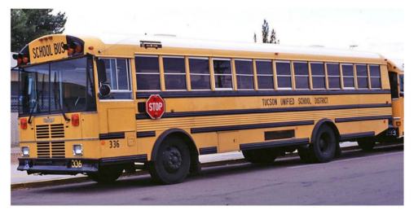
You can go in a bus.

Slide 7
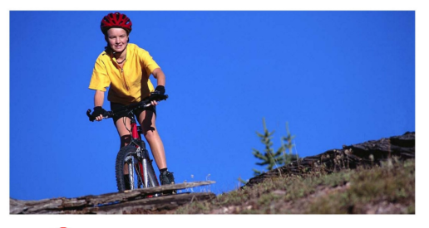
You can go on a bike.

Slide 8
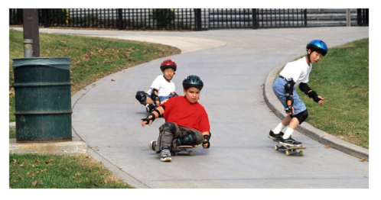
You can go on a skateboard.

Slide 9
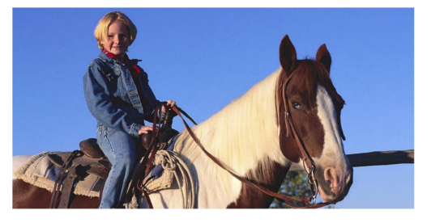
You can go on a horse.

Slide 10
Plane
Car
Train
Boat
Bus
Skateboard
Bike
Horse
Click on the colored buttons to start getting to know them!

Slide 11
You can go on a plane.
Return

Slide 12
You can go on a train.
Return

Slide 13
You can go on a boat.
Return

Slide 14
You can go in a car.
Return

Slide 15
You can go in a bus.
Return

Slide 16
You can go on a bike.
Return

Slide 17
You can go on a skateboard.
Return

Slide 18
You can go on a horse.
Return

